Slide 1
Black Scholes Equation - An Introduction
about the equation, financial lingos, derivation, limitations, assumptions, uses

Slide 2
Black-Scholes Model
Mathematical tool, simulates the dynamics of financial market instruments such as options, futures, forwards and swaps.
It is used to hedge the options in an investment portfolio by buying and selling the underlying asset (such as a stock) in just the right way and as a consequence, eliminate risk.
Black-Scholes equation gives a theoretical estimate of the correct price of European stock options.

Slide 3
Options
An option is a binding contract giving the buyer the right, but not the obligation, to buy or sell an underlying asset at a specific price on or before a certain date.
Offers many advantages that trading stocks and ETFs(exchange transfer funds) alone cannot.
Two types of Options:
Call option - Buying an option that allows you to buy shares at a later time is called a "call option".
Put option - Buying an option that allows you to sell shares at a later time is called a "put option'.

Slide 4
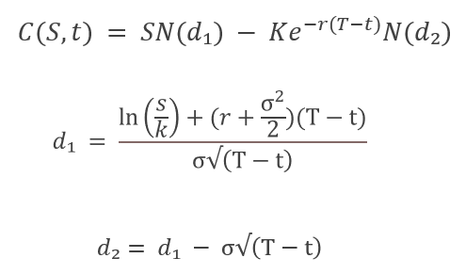
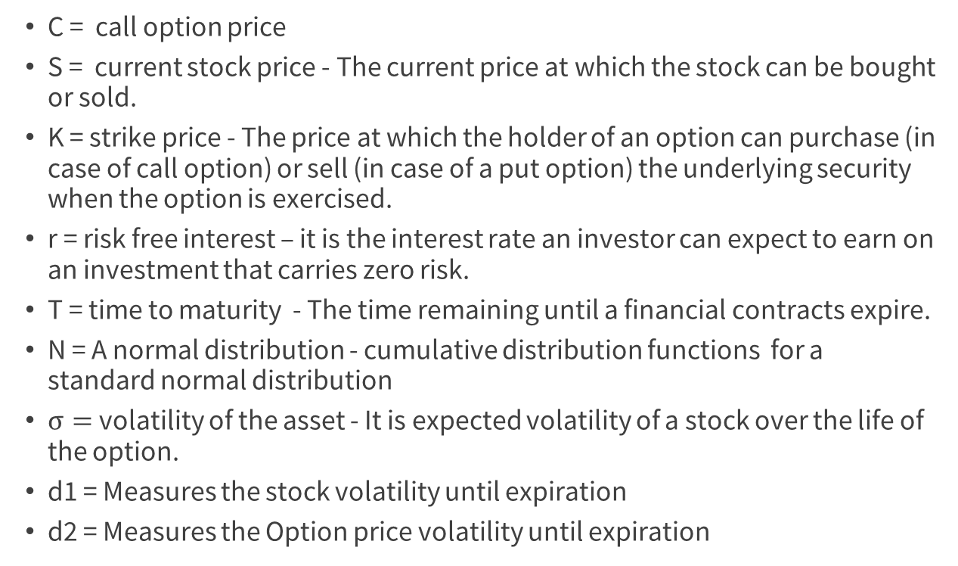
Black - Scholes Equation
C = call option price
S = current stock price - The current price at which the stock can be bought or sold.
K = strike price - The price at which the holder of an option can purchase (in case of call option) or sell (in case of a put option) the underlying security when the option is exercised.
r = risk free interest – it is the interest rate an investor can expect to earn on an investment that carries zero risk.
T = time to maturity - The time remaining until a financial contracts expire.
N = A normal distribution - cumulative distribution functions for a standard normal distribution
$σ=$volatility of the asset - It is expected volatility of a stock over the life of the option.
d1 = Measures the stock volatility until expiration
d2 = Measures the Option price volatility until expiration

Slide 5
Derivation of Black Scholes Equation
Geometric Brownian Motion
ITO’S Lemma
Delta Hedge Portfolio
Major components

Slide 6
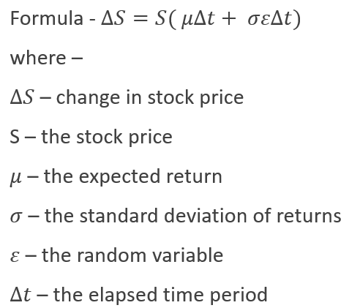
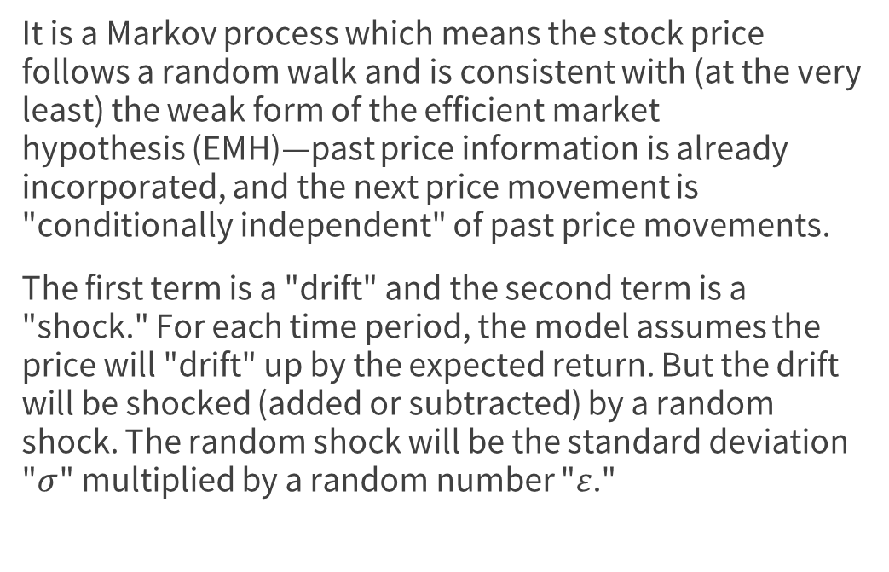
Geometric Brownian Motion
It is a Markov process which means the stock price follows a random walk and is consistent with (at the very least) the weak form of the efficient market hypothesis (EMH)—past price information is already incorporated, and the next price movement is "conditionally independent" of past price movements.
The first term is a "drift" and the second term is a "shock." For each time period, the model assumes the price will "drift" up by the expected return. But the drift will be shocked (added or subtracted) by a random shock. The random shock will be the standard deviation "$σ$" multiplied by a random number "$ε$."

Slide 7
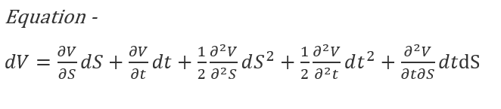
ITO’S Lemma
ITO's Lemma is a key component in the ITO Calculus, used to determine the derivative of a time-dependent function of a stochastic process. It relates the change in the price of the derivative security to the change in the price of the underlying asset.
The equation here represents the change in value of an option as a function of stock price and time.

Slide 8

Delta Hedge Portfolio
Delta-Hedging – it is a defensive tactic used to reduce the directional exposure of a stock or option position. It is accomplished by adding a position that brings the delta closer to zero.
Delta - Delta (Δ) represents the rate of change between the option's price and a $1 change in the underlying asset's price.

Slide 9
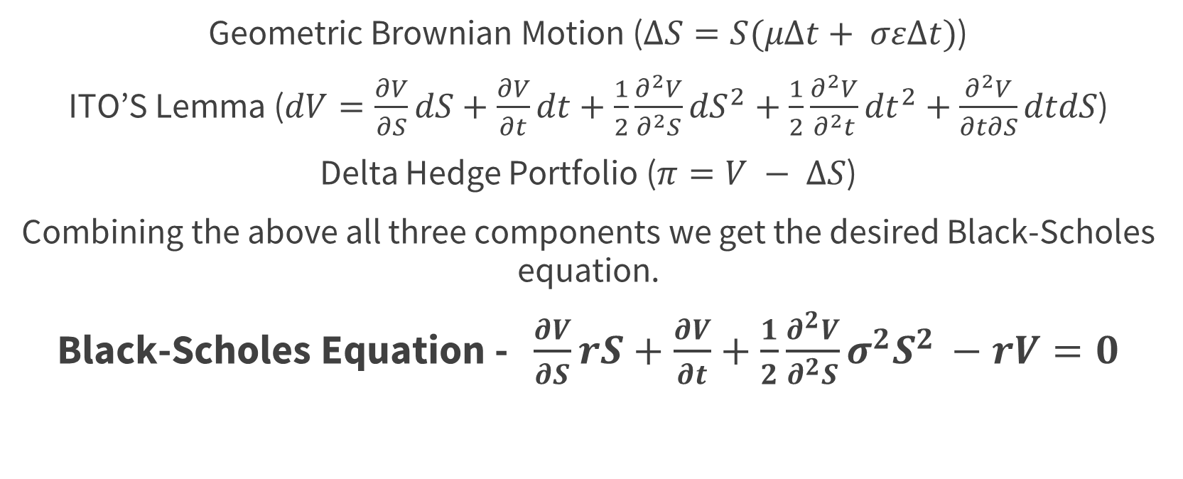
Black Scholes Equation
Geometric Brownian Motion ($ΔS=S(μΔt+ σεΔt)$)
ITO’S Lemma ($dV=\frac{∂V}{∂S}dS+\frac{∂V}{∂t}dt+\frac{1}{2}\frac{∂^{2}V}{∂^{2}S}{dS}^{2}+\frac{1}{2}\frac{∂^{2}V}{∂^{2}t}{dt}^{2}+\frac{∂^{2}V}{∂t∂S}dtdS$)
Delta Hedge Portfolio ($π=V − ΔS$)
Combining the above all three components we get the desired Black-Scholes equation.
Black-Scholes Equation - $\frac{∂V}{∂S}rS+\frac{∂V}{∂t}+\frac{1}{2}\frac{∂^{2}V}{∂^{2}S}σ^{2}S^{2 }−rV=0$

Slide 10
Uses of Black Scholes Equation
Key idea behind the model is to hedge the option by buying and selling the underlying asset in just the right way to eliminate risk.
It lets us calculate a very large number of option price in a very short time.
It gives the theoretical estimate of the price of European style options.
It works entirely on objective figure rather than human judgment.

Slide 11
Limitations and Assumptions
It assumes constant values for risk free return and volatility over the option duration – none of those remain constant in real world.
Assumes continuous and costless trading – ignoring liquidity risk and brokerage charges.
Assumes no dividend pay-out – ignoring its impact on the change in valuations.
Assumes no early exercise (e.g., fits only European options) – the model is unsuitable for American options.

Slide 12
Thank you

